Slide 1
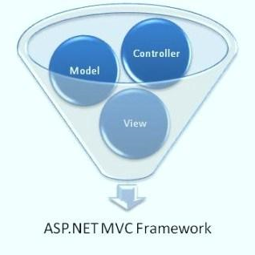
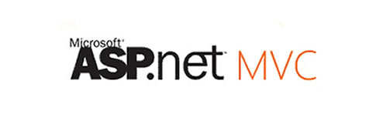


Introduction to ASP.NET MVC
Nikolay Kostov
Team Lead, Senior Developer and Trainer
http://Nikolay.IT
Telerik Software Academy
academy.telerik.com

Slide 2

Table of Contents
The HTTP Protocol
The MVC Pattern
Model, View, Controller
The MVC Pattern for Web and Examples
ASP.NET MVC
Comparison with ASP.NET
ASP.NET MVC Advantages
Creating ASP.NET MVC Project
NuGet Package Management
Server Information with Glimpse

Slide 3
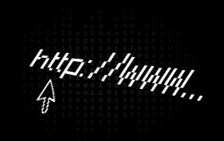

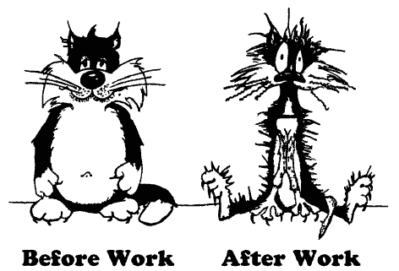
The HTTP Protocol
How HTTP Works?
HTTP

Slide 4
HTTP
Hyper Text Transfer Protocol (HTTP)
Client-server protocol for transferring Web resources (HTML files, images, styles, etc.)
Important properties of HTTP
Request-response model
Text-based format
Relies on a unique resource URLs
Provides resource metadata (e.g. encoding)
Stateless (cookies can overcome this)

Slide 5
HTTP: Request-Response Protocol
Client program
Running on end host
E.g. Web browser
Requests a resource
Server program
Running at the server
E.g. Web server
Provides resources
GET /index.html
HTTP/1.0
HTTP/1.0 200 OK
"Welcome to our
Web site!"
5

Slide 6
HTTP Request Message
Request message sent by a client consists of
Request line – request method (GET, POST, HEAD, ...), resource URI, and protocol version
Request headers – additional parameters
Body – optional data
E.g. posted form data, files, etc.
<request method> <resource> HTTP/<version>
<headers>
<empty line>
<body>

Slide 7
HTTP Response Message
Response message sent by the server
Status line – protocol version, status code, status phrase
Response headers – provide meta data
Body – the contents of the response (the requested resource)
HTTP/<version> <status code> <status text>
<headers>
<CRLF>
<response body – the requested resource>

Slide 8
HTTP Response Codes
HTTP response code classes
1xx: informational (e.g., “100 Continue”)
2xx: success (e.g., “200 OK”)
3xx: redirection (e.g., “304 Not Modified”, "302 Found")
4xx: client error (e.g., “404 Not Found”)
5xx: server error (e.g., “503 Service Unavailable”)
"302 Found" is used for redirecting the Web browser to another URL

Slide 9
HTTP Cookies
Cookie
Cookies are small pieces of data stored by the client on behalf of the server
Included in all future HTTP requests to the server
Request
Response
Set-Cookie: XYZ
Next request
Cookie: XYZ

Slide 10
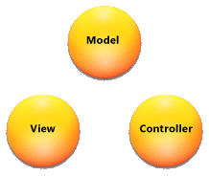
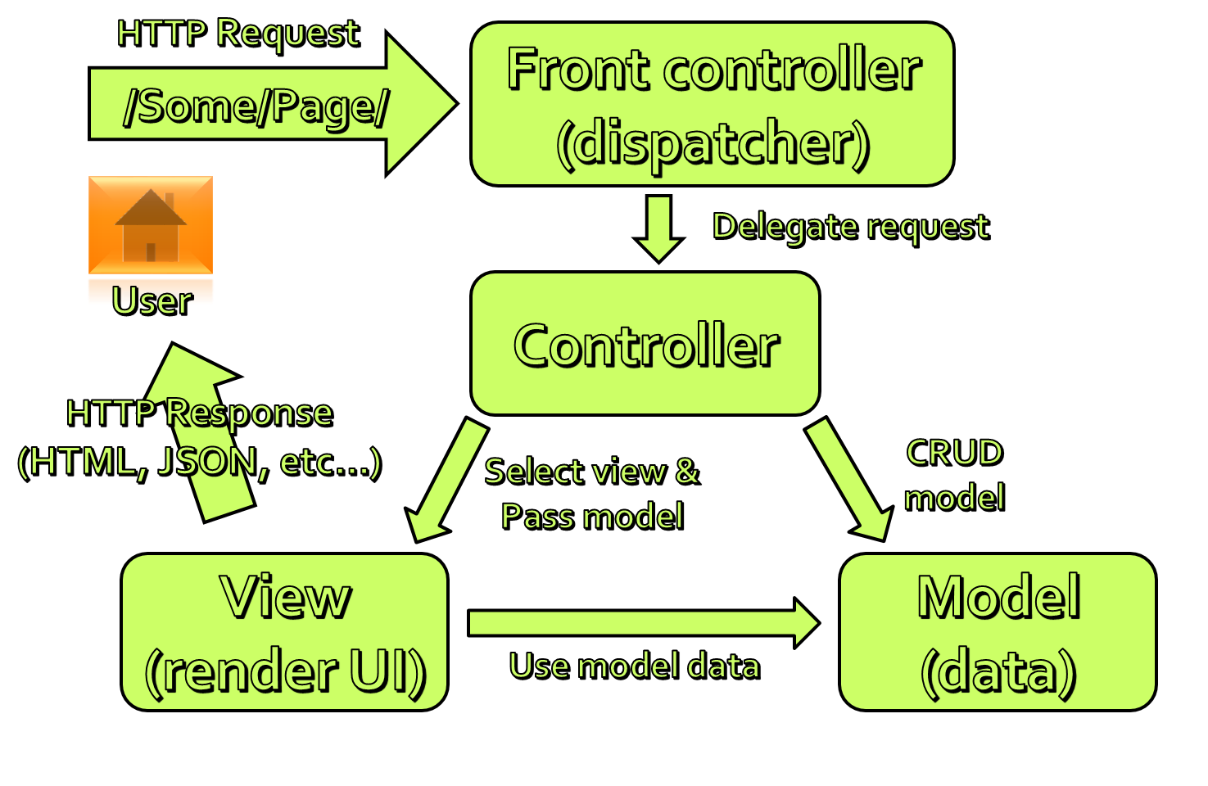
The MVC Pattern

Slide 11
The MVC Pattern
Model–view–controller (MVC) is a software architecture pattern
Originally formulated in the late 1970_{s} by Trygve Reenskaug as part of the Smalltalk
Code reusability and separation of concerns
Originally developed for desktop, then adapted for internet applications

Slide 12

Model
Set of classes that describes the data we are working with as well as the business
Rules for how the data can be changed and manipulated
May contain data validation rules
Often encapsulate data stored in a database as well as code used to manipulate the data
Most likely a Data Access Layer of some kind
Apart from giving the data objects, it doesn't have significance in the framework

Slide 13


View
Defines how the application’s user interface (UI) will be displayed
May support master views (layouts) and sub-views (partial views or controls)
Web: Template to dynamically generate HTML

Slide 14
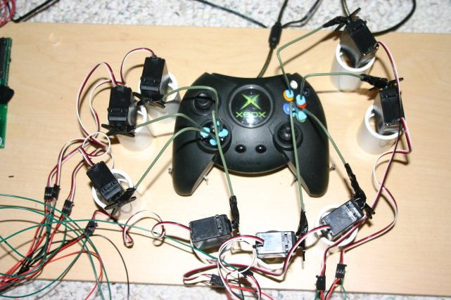
Controller
The core MVC component
Process the requests with the help of views and models
A set of classes that handles
Communication from the user
Overall application flow
Application-specific logic
Every controller has one or more "Actions"

Slide 15
MVC Steps
Incoming request routed to Controller
For web: HTTP request
Controller processes request and creates presentation Model
Controller also selects appropriate result (view)
Model is passed to View
View transforms Model into appropriate output format (HTML)
Response is rendered (HTTP Response)

Slide 16
The MVC Pattern for Web
HTTP Request
/Some/Page/
Front controller (dispatcher)
Delegate request
User
Controller
HTTP Response
CRUD model
Select view & pass data
View
(render UI)
Model (data)
Use model data

Slide 17
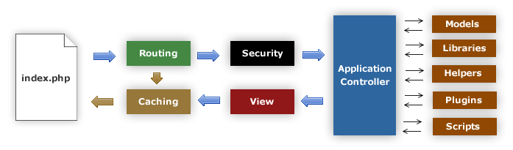
MVC Frameworks
CakePHP (PHP)
CodeIgniter (PHP)
Spring (Java)
Perl: Catalyst, Dancer
Python: Django, Flask, Grok
Ruby: Ruby on Rails, Camping, Nitro, Sinatra
JavaScript: AngularJS, JavaScriptMVC, Spine
ASP.NET MVC (.NET Framework)

Slide 18
ASP.NET MVC

Slide 19
ASP.NET Core
ASP.NET WebForms
ASP.NET
MVC
Presentation
ASP.NET
Caching
.NET
Globalization
Pages
Controls
Master Pages
Runtime
Profile
Roles
Membership
Routes
Handlers
Etc...

Slide 20
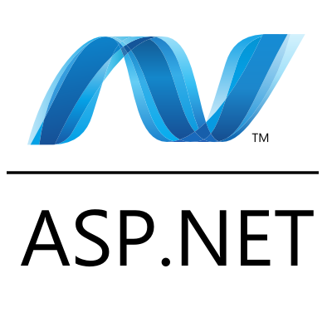
ASP.NET Web Forms
Stable and mature, supported by heaps of third party controls and tools
Event driven web development
Postbacks
Viewstate
Less control over the HTML
Hard to test
Rapid development

Slide 21
ASP.NET History
Classic ASP introduced in late 1990's
ASP.NET 1.0 – 2002 (Web Forms)
ASP.NET 2.0 – 2005 (Data management)
ASP.NET 3.5 – 2008 (First version of MVC)
Two more versions in next two years
ASP.NET 4 – 2010 (VS 2010, MVC 2.0, Razor)
ASP.NET 4.5 (First version of Web API, VS 2012)
February 2013 – SignalR
Autumn 2013 – VS 2013, One ASP.NET, MVC 5

Slide 22
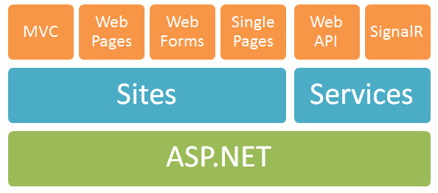
One ASP.NET
Web Forms
Component-based
ASP.NET MVC
Web Pages
Lightweight framework for dynamic content
Web API
Framework for building RESTful Web services
SignalR
Real-time client-server communication

Slide 23
ASP.NET MVC
Runs on top of ASP.NET
Not a replacement for WebForms
Leverage the benefits of ASP.NET
Embrace the web
User/SEO friendly URLs, HTML 5, SPA
Adopt REST concepts
Uses MVC pattern
Conventions and Guidance
Separation of concerns

Slide 24
ASP.NET MVC (2)
Tight control over markup
Testable
Loosely coupled and extensible
Convention over configuration
Razor view engine
One of the greatest view engines
With intellisense, integrated in Visual Studio
Reuse of current skills (C#, EF, LINQ, JS, etc.)
Application-based (not scripts like PHP)

Slide 25
The ASP.NET MVC History
ASP.NET MVC 1.0
In February 2007, Scott Guthrie ("ScottGu") of Microsoft sketched out the core of ASP.NET MVC
Released on 13 March 2009
ASP.NET MVC 2.0
Released just one year later, on 10 March 2010
ASP.NET MVC 3.0 – 13 January 2011
ASP.NET MVC 4.0 – 15 August 2012
ASP.NET MVC 5.0 – Later this year (2013)
Release Candidate is currently available

Slide 26
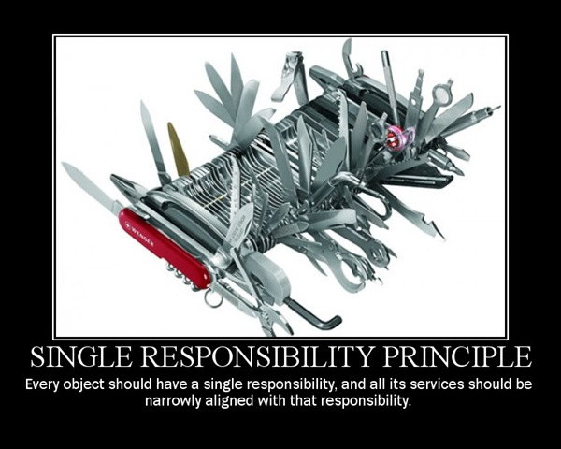
Separation of Concerns
Each component has one responsibility
SRP – Single Responsibility Principle
DRY – Don’t Repeat Yourself
More easily testable
TDD – Test-driven development
Helps with concurrent development
Performing tasks concurrently
One developer works on views
Another works on controllers

Slide 27
Extensible
Replace any component of the system
Interface-based architecture
Almost anything can be replaced or extended
Model binders (request data to CLR objects)
Action/result filters (e.g. OnActionExecuting)
Custom action result types
View engine (Razor, WebForms, NHaml, Spark)
View helpers (HTML, AJAX, URL, etc.)
Custom data providers (ADO.NET), etc.

Slide 28
Clean URLs
REST-like
/products/update
/blog/posts/2013/01/28/mvc-is-cool
Friendlier to humans
/product.aspx?catId=123 or post.php?id=123
Becomes /products/chocolate/
Friendlier to web crawlers
Search engine optimization (SEO)

Slide 29
Community-based
ASP.NET MVC, Web API, and Web Pages source code is available in CodePlex:
http://aspnetwebstack.codeplex.com/
You can vote for new features in ASP.NET UserVoice site
http://aspnet.uservoice.com/forums/41199-general-asp-net
http://aspnet.uservoice.com/forums/41201-asp-net-mvc

Slide 30
MVC Pattern in ASP.NET MVC
HTTP Request
Web server
ASP.NET MVC Routing engine
/Users/Niki/
Select controller and invoke action (method)
User
Controller
(C# class)
HTTP Response
(HTML, File, JSON, …)
Select view & pass data (model)
CRUD model
View engine
(Razor)
Model (POCO)
Use model data

Slide 31
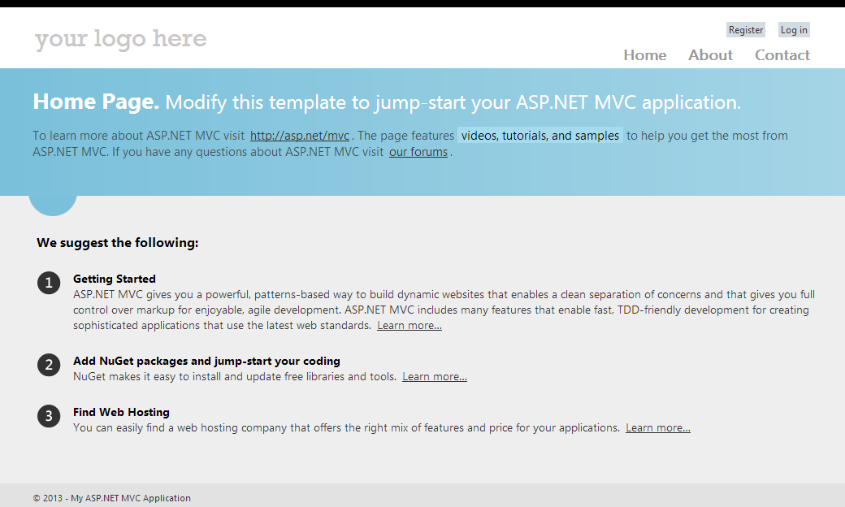
Creating ASP.NET MVC Project

Slide 32
The Tools
Tools that we need:
IDE: Visual Studio 2013 (2012 is also OK)
Visual Studio RC version is preferable
Framework: .NET Framework 4.5
Web server: IIS 8 (Express)
Data: Microsoft SQL Sever (Express or LocalDB)
Visual Studio installer will install everything we need
http://www.microsoft.com/visualstudio/eng/2013-downloads

Slide 33
The Technologies
Technologies that ASP.NET MVC uses
C# (OOP, unit testing, async, etc.)
ASP.NET
HTML(5) and CSS
JavaScript (jQuery, KendoUI, etc.)
AJAX, Single-page apps
Databases (MS SQL)
ORM (Entity Framework and LINQ)
Web and HTTP

Slide 34
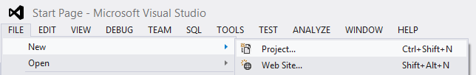
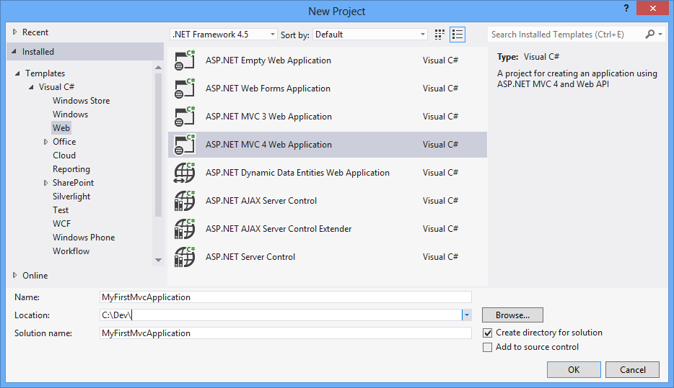
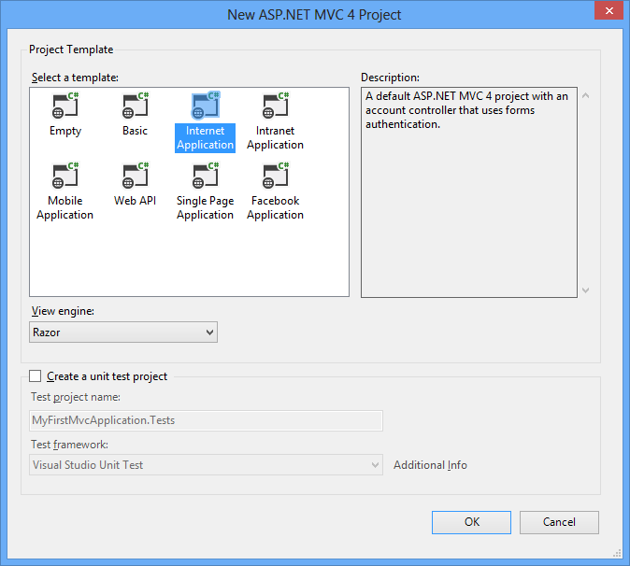
Visual Studio 2012: New Project

Slide 35
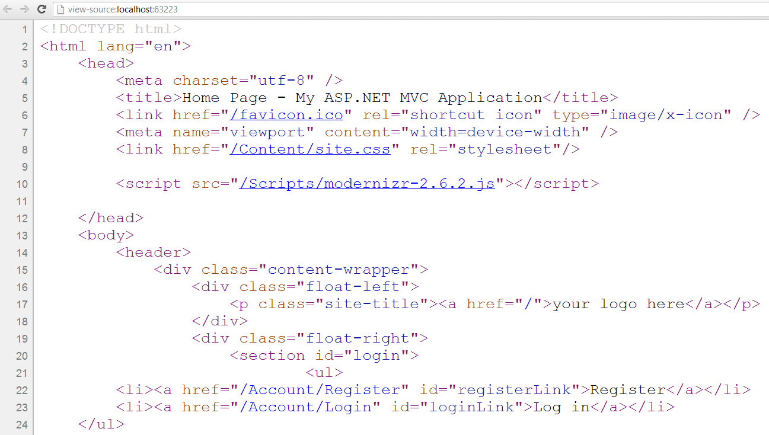
VS 2012: Default Layout

Slide 36

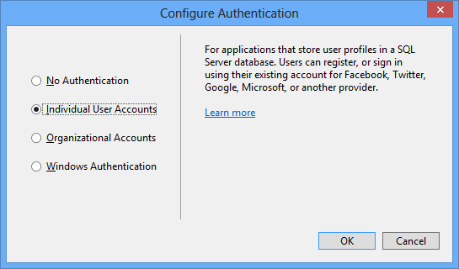
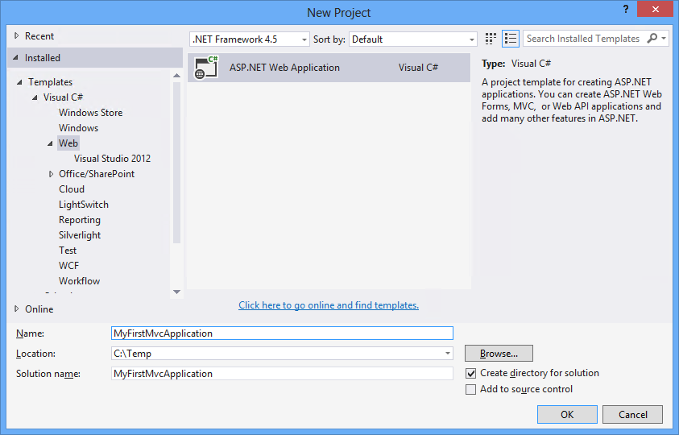
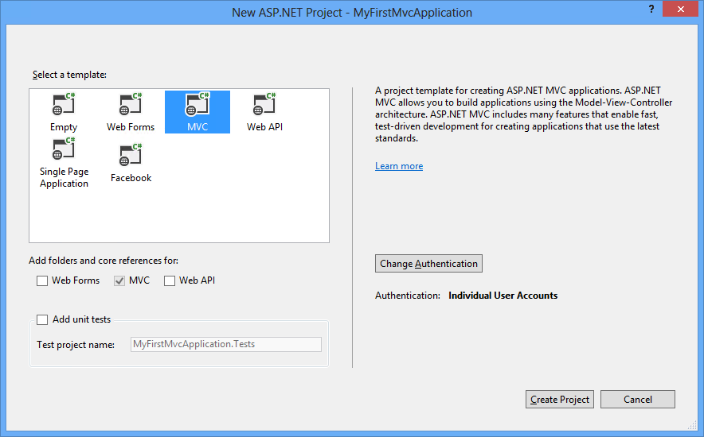
Visual Studio 2013: New Project

Slide 37
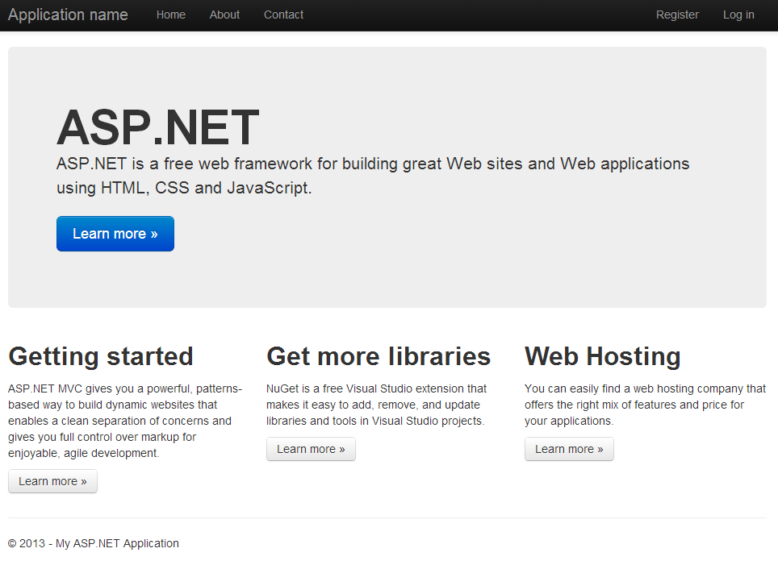
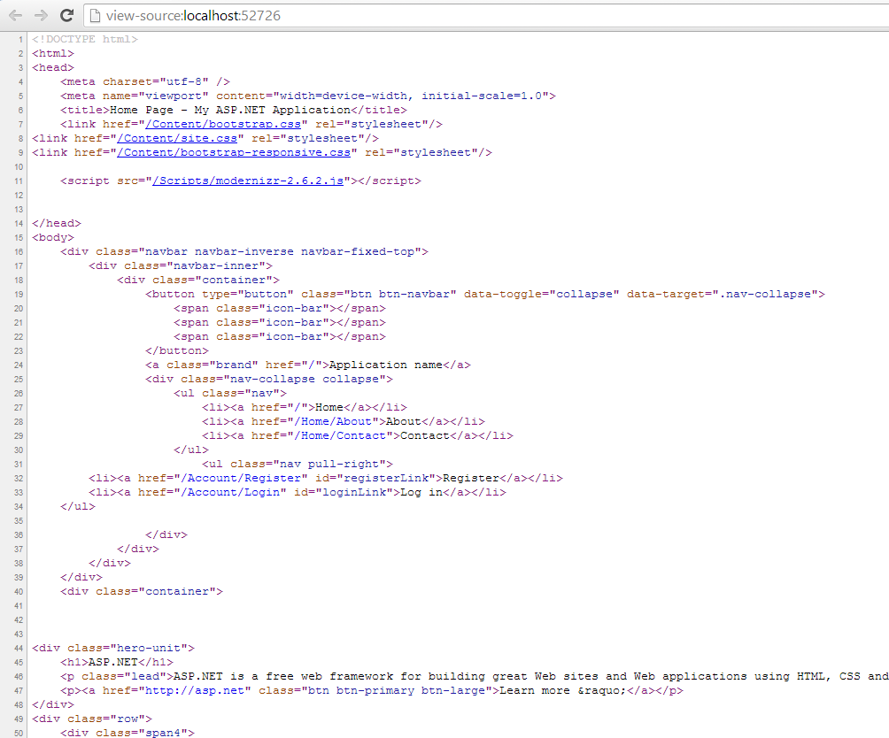
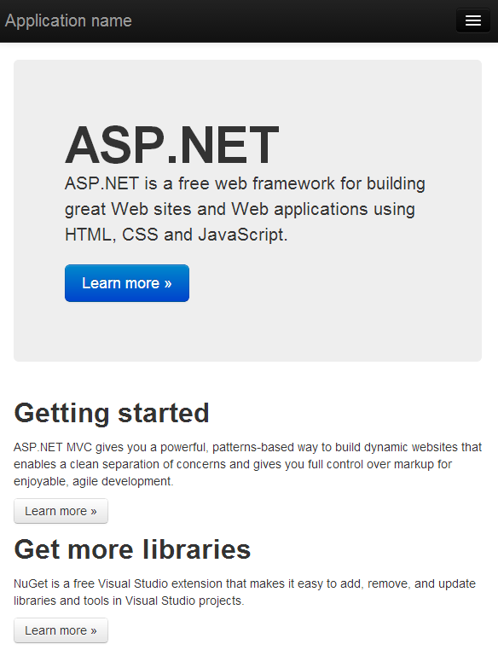
VS 2013: Default Layout

Slide 38
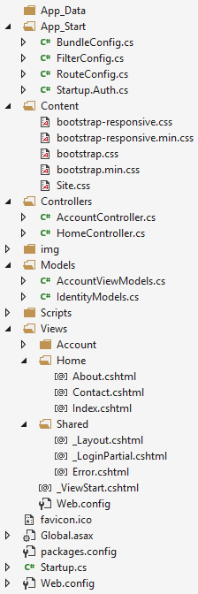
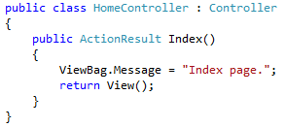
Internet App Project Files
Static files (CSS, Images, etc.)
All controllers and actions
JavaScript files (jQuery, Modernizr, knockout, etc.)
View templates
_Layout.cshtml – master page (main template)
Application_Start() – The entry point of the application
Web.config – Configuration file

Slide 39
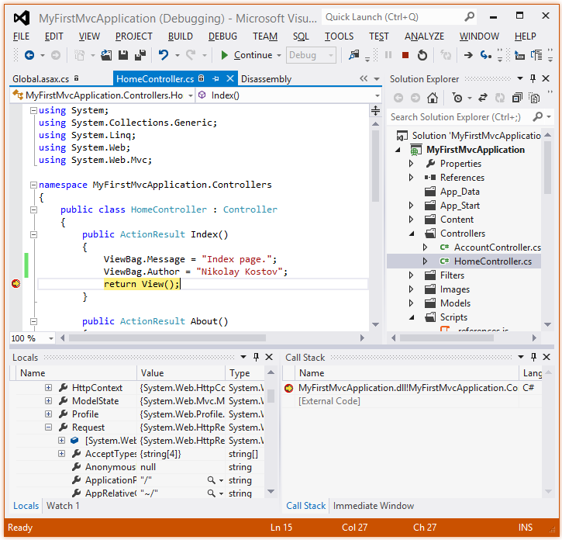
Demo: Internet application
Making changes and debugging

Slide 40

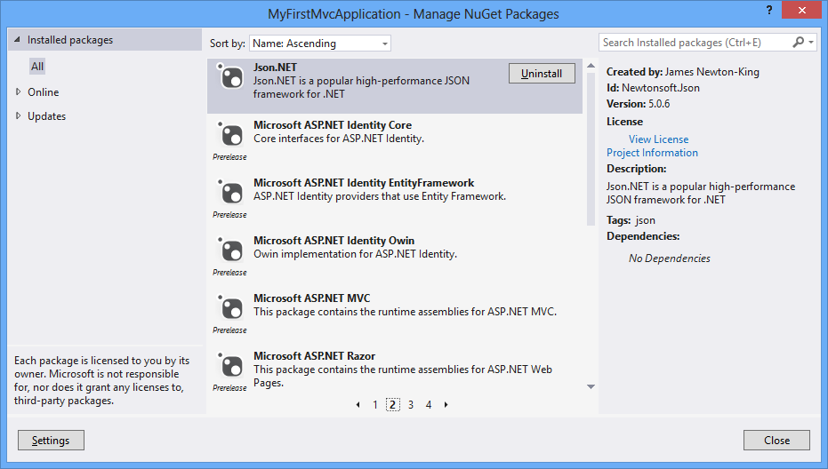
NuGet Package Management

Slide 41
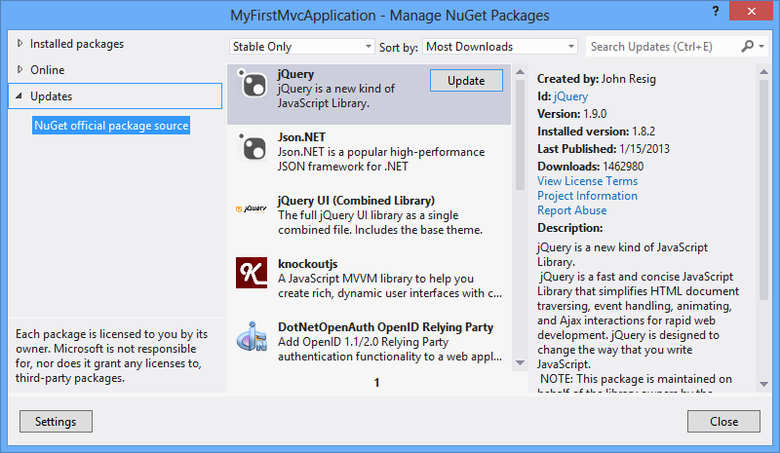
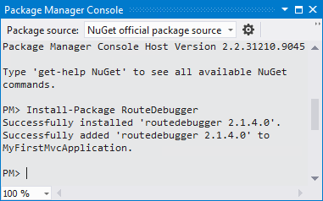
NuGet package management
Free, open source package management
Makes it easy to install and update open source libraries and tools
Part of Visual Studio 2012/2013
Configurable package sources
Simple as adding a reference
GUI-based package installer
Package manager console

Slide 42
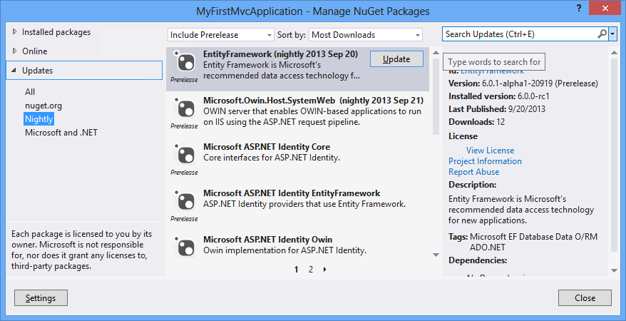
Nightly Builds
Nightly builds of ASP.NET MVC are available via a private NuGet feed
In your Package Manager settings add the following package source:
http://www.myget.org/F/aspnetwebstacknightly/

Slide 43
Demo: NuGet
Install and update packages as easy as adding a reference

Slide 44
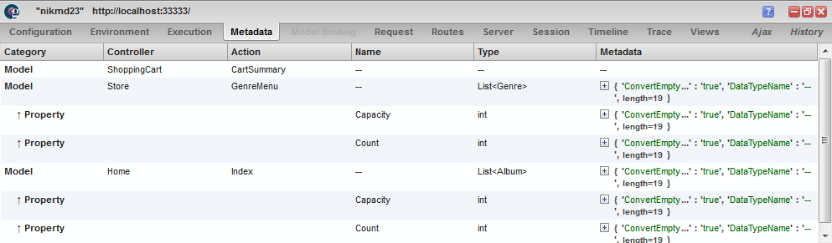

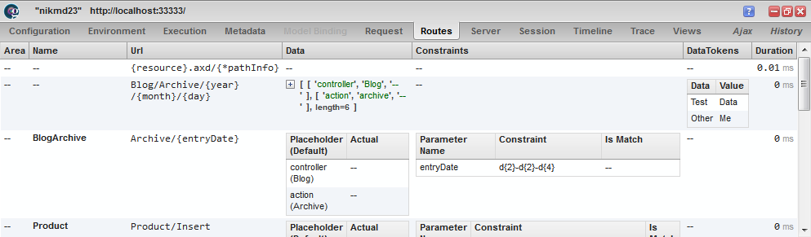
Server Information with Glimpse
The open source diagnostics platform of the web

Slide 45
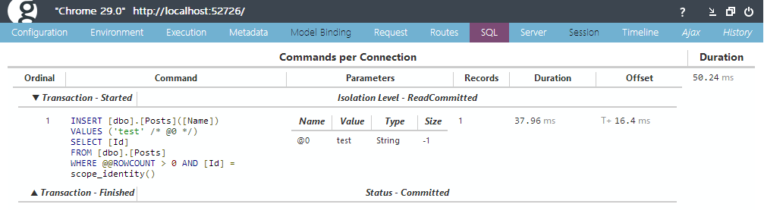
Server Info with Glimpse
Glimpse shows execution timings, server configuration, request data and more
Showed inside browser (like FireBug)
With no changes to the application code
Supported ASP.NET MVC, WebForms and EF

Slide 46
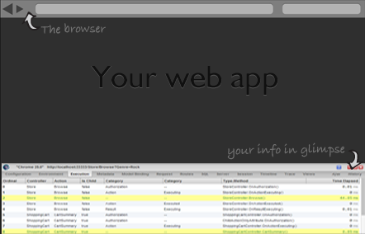
Install Glimpse
Install NuGet packages:
Glimpse.Mvc4
Glimpse.EF6
Run the project
Configure it:
http://localhost:port/Glimpse.axd
Beware: Currently "Glimpse.EF6" doesn't work with the new identity system

Slide 47
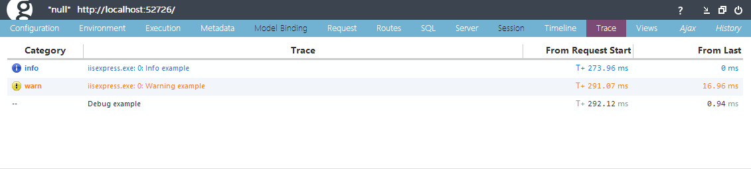
Tracing with Glimpse
The Trace tab shows any messages traced to System.Diagnostics.Trace or System.Diagnostics.Debug during the lifetime of the HTTP request.
Trace.TraceInformation("Info example");
Trace.TraceWarning("Warning example");
Debug.WriteLine("Debug example");

Slide 48
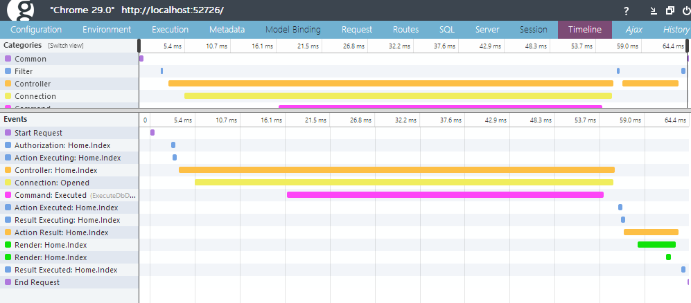
Demo: Glimpse

Slide 49
Summary
HTTP is a client-server protocol for transferring web resources via Internet
Model–view–controller (MVC) is a software architecture pattern
ASP.NET MVC is a great platform for developing Internet applications
Visual Studio is the main development tool for creating ASP.NET MVC applications
Almost everything in ASP.NET MVC is a package
Glimpse is a tool that helps with debugging

Slide 50
Introduction to ASP.NET MVC
http://academy.telerik.com

Slide 51



Free Trainings @ Telerik Academy
“C# Programming @ Telerik Academy
csharpfundamentals.telerik.com
Telerik Software Academy
academy.telerik.com
Telerik Academy @ Facebook
facebook.com/TelerikAcademy
Telerik Software Academy Forums
forums.academy.telerik.com

